Slide 1
How to Reduce Traffic Collisions in Brooklyn
An analysis of traffic collision data provided by the NYPD for the Brooklyn city council to inform new legislation and/or projects in 2020

Slide 2
How to Reduce Collisions in Brooklyn?
Overall Agenda:
Data Sources, Assumptions, & Summary
Area of Focus 1: How to Prevent Rush Hour Collisions
Area of Focus 2: How to Prevent Alcohol Related Collisions
Area of Focus 3: How to Prevent Cyclist & Pedestrian Collisions
Conclusions and Budgeting for Projects and Measures

Slide 3
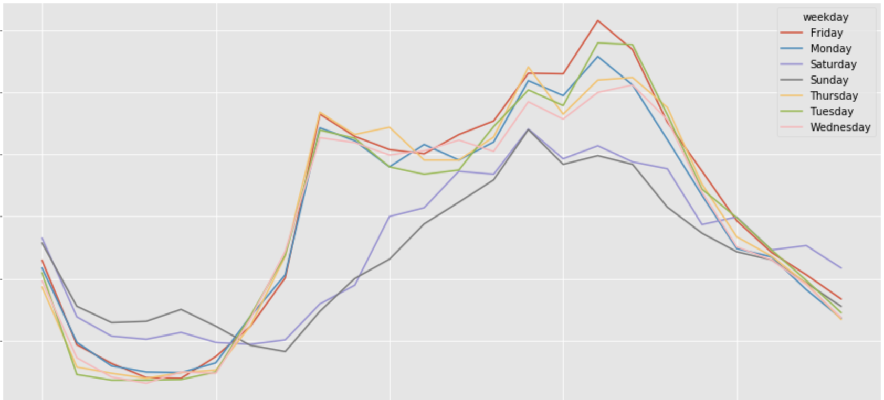
There are 3 main areas of improvement from a public health and safety standpoint: Rush Hour (RH) collisions, Alcohol-Related (AR) collisions, & Cyclist/Pedestrian (CP) collisions.
Accidents by Hour and Day of Week in Brooklyn
From 1/1/2017 onwards
Comments
Collisions YoY are down 6.4% from 2016 to 2017.
The borough of Brooklyn has 47,099 vehicle collisions in 2017 & 2018¹
42% of collisions occurred during Rush Hour on weekdays (8-10 am & 4-7 pm)
10% of all accidents occur on large roads (3 lanes or more) or parkways.
Major intersections of accidents are high traffic routes with connections into Manhattan:
Tillary Street and Flatbush Avenue
Ocean Parkway and Avenue J
Atlantic Avenue and Eastern Parkway
Number of Accidents
100 200 300 400 500 600
12 am 5 am 10 am 3pm 8pm
Once preliminary analysis was complete, the graph above helped identify areas to focus in more detail.
The white boxes indicate the spikes during RH
The black boxes indicate the spikes of AC
CP was chosen independently of the data presented here
¹ The NYPD collects vehicle collision data for all police reported motor vehicle collisions in NYC (either $1000 of damage or if personal injury has taken place). In order to identify how best to remedy traffic in Brooklyn, the data was filtered to only Brooklyn tagged¹ collisions from 1/1/2017 onwards as this is more indicative of current traffic patterns given data availability.

Slide 4
Rush Hour (RH) collisions dropped 3.1% from 2016 to 2017; Nevertheless, 14K collisions occurred in 2016 and 2017, so the question becomes what steps can the city council take to mitigate delays caused by collisions at rush hour?
Cause 1: Lack of driver awareness of their surroundings causes ~65% of all accidents during rush hour at the most accident-prone² intersections.
Recommendation 1: Rumble strips, billboards or increased ticketing for using cell phones while driving may help drivers avoid distractions and pay attention to the road.
Cause 2: Improper lane usage causes ~30% of all accidents during rush hour at the most accident prone² intersections in Brooklyn.
Recommendation 2: Stoplight Cameras, repainted solid lane lines & turn lane pavement markings, signs indicating no passing/turning at intersections, or increased ticketing will reduce driver lane impropriety.
CAUSES OF COLLISIONS IN MAJOR INTERSECTIONS DURING RUSH HOUR IN 2017
Accidents Caused by Driver’s Lack of Awareness
Accidents Caused by Driver’s Improper Lane Usage
During rush hour (8AM - 10AM & 4PM – 7PM), commuting out of and into Brooklyn, there are ~14K accidents and 8 major identified causes of accidents, which can be bucketed into 2 subcategories: Driver Lack of Awareness and Improper Lane Usage.
2: Intersections were identified by first restricting the data to all collisions that took place within the hours of 8-10 am and 4 pm – 7 pm on weekdays. Using the latitudes and longitudes identified by the police office in the collision report, the intersections with the most recorded accidents were chosen and from there, the reasons for the accidents were sourced.

Slide 5
Alcohol Related (AR) Collisions increased 76% YoY.
What are some possible solutions to incentive users to use other methods of transit when drinking?
AR COLLISIONS BROKEN DOWN BY TOP 5 VEHICLE TYPES
IN 2016 AND 2017
The most frequent neighborhoods of collisions have moved from Prospect Heights and Coney Island to the Flatbush and East Flatbush Neighborhoods.
Recommendation 1: More Sobriety / DUI checkpoints in the East Flatbush / Flatbush / surrounding neighborhoods.
Utica and Lenox
Glenwood and E 46 St
Flatbush and Empire
Recommendation 2: Partner with Rideshare companies or NYC Cab services to provide citizen with a safe ride home and reduced overnight parking fees.
(NYC already partners with STOP-DWI which allows users to plan their night, ensuring they have a safe way to get home without driving drunk)
CAUSE OF COLLSION | 2016 | 2017 | % Change
PASSENGER VEHICLE | 232 | 364 | +57%
SPORT UTILITY / STATION WAGON | 91 | 196 | +115%
BICYCLE | 3 | 17 | +467%
PICK-UP TRUCK | 8 | 15 | +88%
TAXI | 4 | 12 | +200%
Total Alcohol Related Collisions:
+ 76% YoY
Total Alcohol Related Injuries:
+ 52% YoY
NYS STOP-DWI Mission is to
1) Reduce the number of persons killed or injured in alcohol and other drug-related traffic crashes
2) To promote DWI prevention as a public priority
3) Coordinate local efforts in Law Enforcement, Prosecution, Probation, Rehabilitation, Public Information, Education, and Administration.

Slide 6
Cyclist & Pedestrian (CP) collisions³ dropped 8% from 2016 to 2017; What steps can the city council take to make streets even safer for non-vehicular travelers?
Cause 1: Right of way is unclear for pedestrians, cyclists and motorists.
Recommendation 1: Clearly painted pedestrian X-ings, bike lanes, updated walk signals attached to traffic lights, and cross walk signage must be in place at all key transit intersections. Even if there is a bike lane on one street, there is no bike lane to turn onto safely at the 3 most collision prone intersections.
Cause 2: Driver Inattention causes the largest share of cyclist collisions and second largest share of pedestrian collisions
Recommendation 2: Street signs to look in their blind spots for cyclists, billboards and flashing right of way signals are all ways to remind motorists to stay vigilant of cyclists and pedestrians in their blind spot.
CAUSES OF CP COLLISIONS IN MAJOR INTERSECTIONS DURING RUSH HOUR IN 2017
³ Data sourced from all accidents which caused at least 1 pedestrian / cyclist injury or death in 2017 and 2018 in Brooklyn. These are the top 4 identified reasons for cyclist and pedestrian injury (injuries related to backing up for pedestrian collisions were excluded as there is no clear solution to resolving this other than additional signage at parking meters or alleyways.

Slide 7
Key Insights Becoming Priorities – How to Reduce Accidents in Brooklyn
Final Recommendation: running a pilot on 20 cross streets for 3 months to see if the proposed solutions would lead to a decrease in collisions (can choose a mix of both high collision and medium collision areas)
Key Insights: Drivers of Collisions in Brooklyn
Est. Cost
Potential Priorities for 2020
#1
Lack of Driver Awareness
Rumble strips *
Billboards & signage for increased ticketing for cellphone violations while driving *
$ 2M
Increased ticketing / stop light cameras for lane violations *
Repainted Solid Lane Lines
No passing / turning signs at intersections *
#2
Improper Lane Usage
$ 8M
#3
Alcohol Impairment
More Police led Sobriety Checkpoints
Additional community resources into safe free sober rides
$ 3M
Additional bikeways/bike paths
Repainted Ped X-ings, Turn Lanes, & Crosswalks
Updated walk signals
$ 5M
#4
Unclear Right of Way between Cyclists, Pedestrians, and Motorists
$18 M is a reasonable estimation given the pilots happening in NYC for $10M**, so the council can choose to adopt certain aspects of the plan, or look to bond measures to fund these projects going forward.
* See cost (back of the envelope) breakdown in appendix where costs were available. Estimated costs total ~$11.5M, for all other items assumed cost is ~$6.5M
** https://www.wsj.com/articles/nyc-cars-to-talk-to-one-another-under-traffic-safety-pilot-program-1541452455

Slide 8
Appendix: Cost Breakdown

Slide 9
Cost Breakdown: Back of the Envelope
Rumble Strips Materials Cost: $6000 / mile * 10 miles = $ 60,000
Installation Cost: $20 / hr. * 60 hrs. / week * 6 weeks * 20 men = $144,000
Billboards: $30000 / month * 15 billboards * 3 months = $1,350,000
Signage at every intersection Raw Materials: $ 300 /sign * 8 signs * 20 intersections
= $ 48,000
Installation Cost of Signage: $20 / hr. * 40 hrs. / week * 6 weeks * 15 men = $72,000
Red Light Cameras: $100000 / camera * 4 cameras / intersection * 20 intersections
= $ 8,000,000
Police Presence: $90,000 / year * .25 years * 80 people = $1,800,000
https://dashtwo.com/blog/how-much-does-billboard-advertising-cost/
https://www.cdc.gov/motorvehiclesafety/calculator/factsheet/redlight.html

